Slide 1


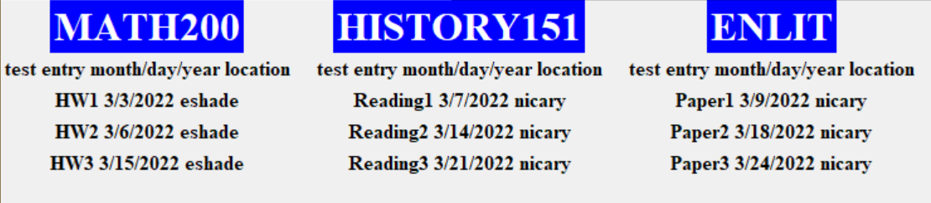
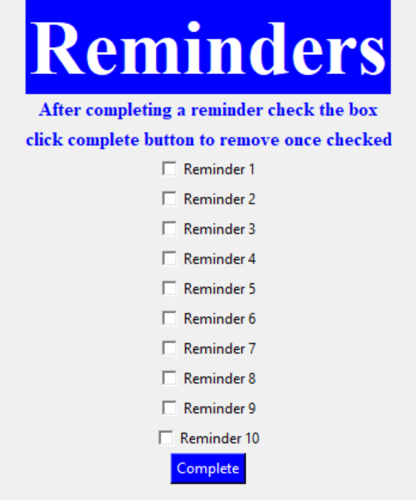
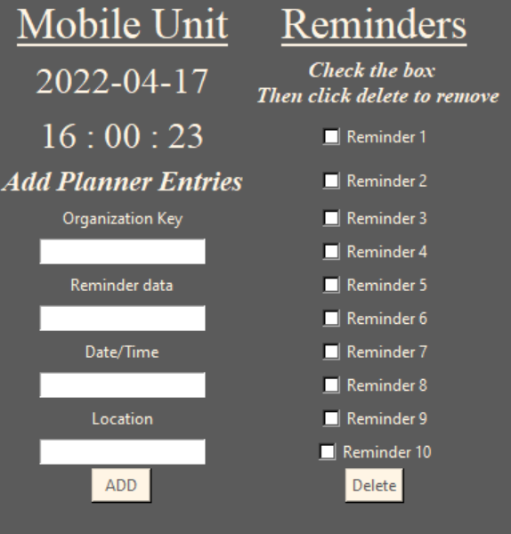
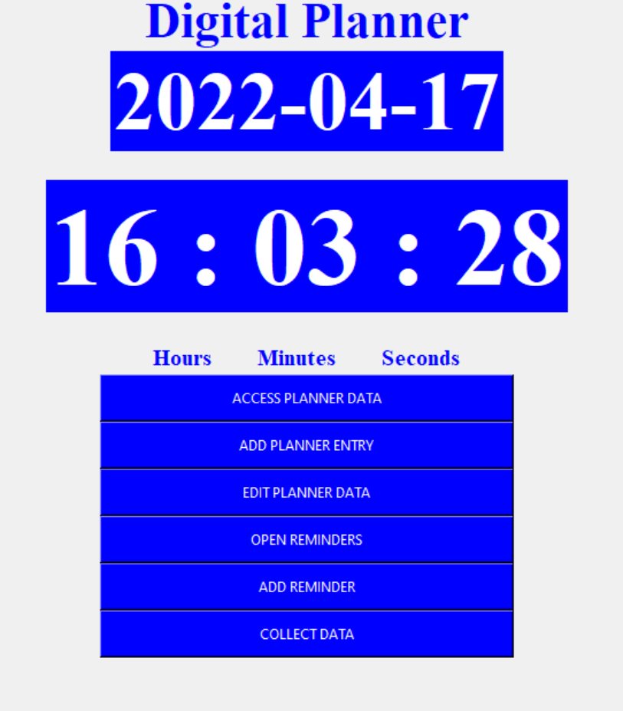
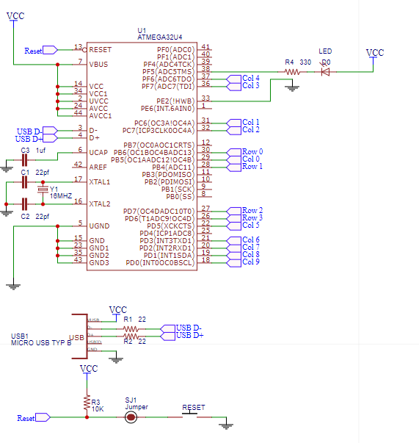
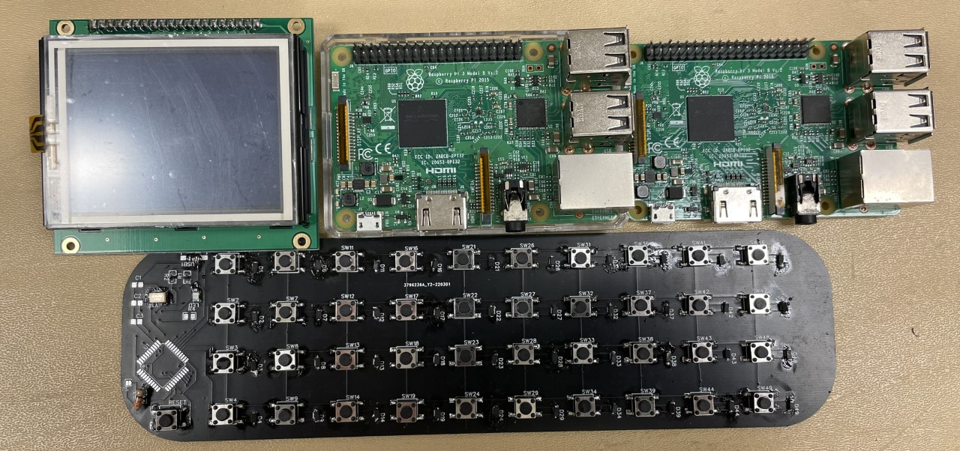
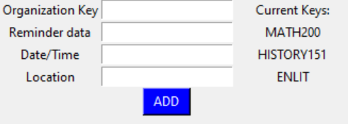
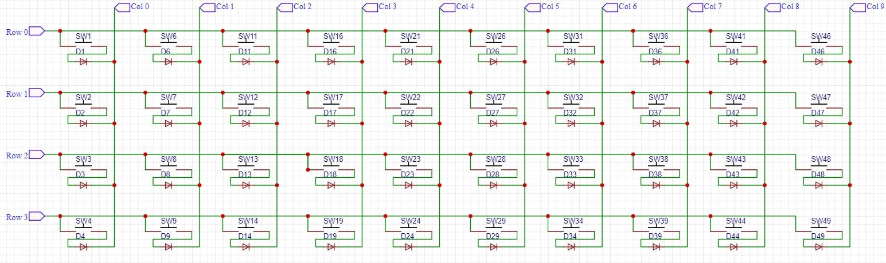
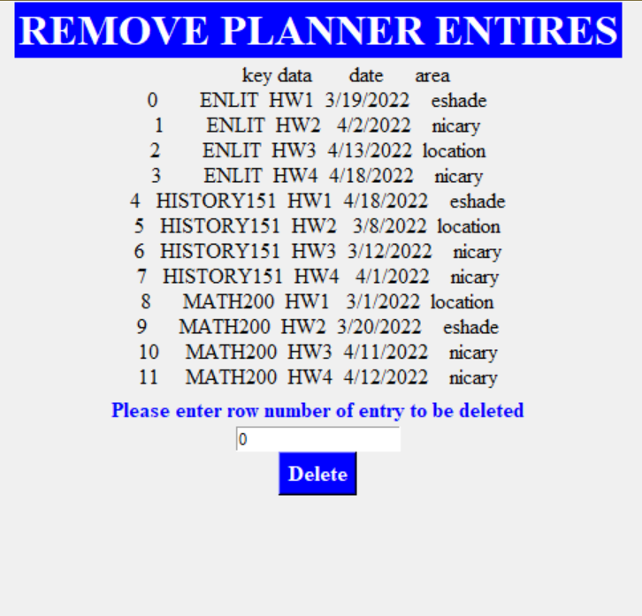
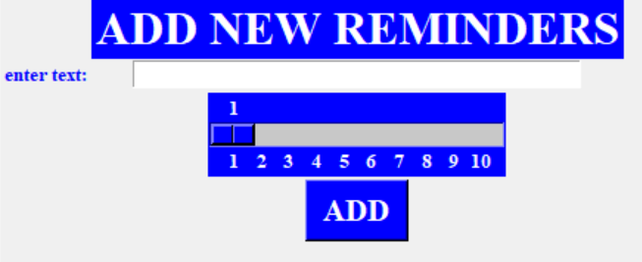
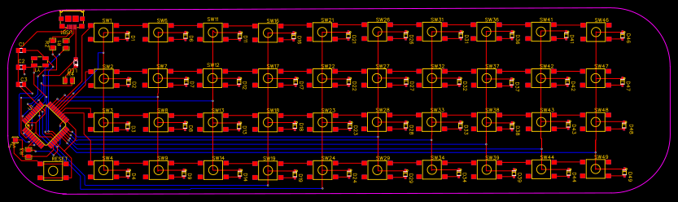
Digital Planner System
Parker James Tribble BS in Computer Engineering 2022
Dr. Joseph T Wunderlich Ph.D.
OPPORTUNITY
Smart phones are quickly becoming more addicting as social media and other applications work to keep the users engaged as much as possible. To combat this, the digital planner system is designed to help increase productivity and improve one's relationship with technology. This planner system will have no distractions while still providing the same capabilities of a smart phone planner application.
TECHNICAL DESIGN
PCB Keyboard:
PROTOTYPE/DEVICE/PROCESS
Left: Microcontroller ATMega32u4 connections to PCB
Middle: Design of keyboard matrix
Bottom: 2-layer PCB design (Gerber file)
View planner window
View reminders window
Mobile unit GUI
Terminal GUI
Planner entry window
DESIGN SPECIFICATIONS
Top row: LCD Screen, terminal and mobile unit raspberry PI. Bottom Row: PCB Keyboard
Add reminders window
Remove planner entry window
Goal: Create an easy-to-use digital planner that automatically organizes entries and outputs easy to understand GUI
Terminal:
Linux Ubuntu OS on Raspberry PI
Receive data from mobile unit via sftp
Python program:
Organize data and output into CSV file and GUI
Set reminders to be displayed on mobile unit
Mobile Unit:
Linux Ubuntu OS on Raspberry PI
PCB keyboard and 3.5-inch LCD Display
Python program:
Take in planner entries and save them locally
Display GUI for user to input planner entries
Display user’s current reminders
PCB Keyboard:
Keyboard with 40 keys:
26 for the alphabet. 10 for single digit numbers. 3 for space, backspace, and enter. 1 key for navigating the GUI (similar to tab key)
TESTING
Input testing: feed a series of different strings, integers, and unique characters to test if any do not function with in the code
Results: no characters or length of input would affect the program
Input testing: continue adding entries and reminders until the program stops functioning properly
Results: It was determined that the for functionality, a limit of 10 daily reminders was set. No limit needed for planner entries
Data Transfer: Transfer data from mobile unit to terminal writing over the CSV files that the programs read from
Results: Errors within data transfer come from either of the units lacking network connection or the SFTP server is not reachable
Firmware: testing of the keymap and firmware of the PCB keyboard was preformed on desktop keyboard to ensure functionality during keyboard assembly
Keyboard: after testing the firmware the keyboard should function properly. Any problems present will be hardware related.
IMPACT
This project is aimed to encourage the production of quality digital products that are designed to last and help people. Technology should assist or improve people’s lives, not aim to take it over to keep engagement numbers up.
Software:
Add Planner Entry:
Opens window using TK top-level function restricting use to single window.
Displays 4 entry boxes, an “ADD” button and a list of current organization keys in use
START
START
Check for saved data
View Planner:
Opens window using TK top-level function restricting use to single window.
Window displays each organization key with a list of planner entries associated with it below
Check for saved data
Edit Planner Data:
Opens window using TK top-level function restricting use to single window.
The window will have the user select which data key they want to view then allow for those planner entries to be deleted
Read in data from CSV to date frames
Create CSV file for saving entries
Read in data from CSV to date frames
Create CSV file for saving entries
Add Reminder:
Opens window using TK top-level function restricting use to single window.
The window has a text entry box for the reminders data and a scroll bar to set its priority number
REFERENCES AND ACKNOWLEDGEMENTS
[1] w4ilun github.com/w4ilun
[2] ubuntu.com
[3] kbfirmware.com
[4] github.com/tmk/tmk_keyboard
[5] pandas.pydata.org
[6] docs.python.org/3/library/tkinter.html
Special thanks to:
Dr Joseph T Wunderlich & Matthew Grohotolski for technical support
Gio V, Lizzy Z, Louis S, for brainstorming sessions and creative input
Grant, Jim, Beth, and Ming Tribble for daily inspiration
Start main loop of GUI and displays:
4 entry boxes and “ADD” button
List of organizational keys in use
List of 10 daily reminders
Organize data based on Key in data frame then write is over the CSV File to update
View Reminders:
Opens window using TK top-level function restricting use to single window.
This window will display a list of ten reminders as check boxes, if checked and the delete button is pushed, the reminder will be deleted
Start main loop of GUI
Display 6 Buttons:
Add Planner Entry, View Planner, Edit Planner Data, Add Reminder, View Reminder, Collect Data
View Reminders
Auto-updating time and date functions
Button Pressed?
Collect Data:
Initiate data transfer from specific folder in mobile unit into active folder in the terminal unit using SFTP. The data will then be organized by key after collection is complete.
Entered Data is saved into local Data Frame and CSV.
Entry boxes are cleared
Current key list is updated
Figure 3: Terminal:
Raspberry PI 3B V1.2 Running Ubuntu OS. Utilizes Tkinter library for GUI and utilizing Panda's library along with objects to handle data entries. The Terminal also acts as the host server for the SFTP data transfer from the Mobile unit.
Figure 2: Mobile Unit:
Raspberry Pi 3B V1.2 running Ubuntu OS. Utilizes Tkinter library for GUI and Pandas library with objects to handle data entries
Capstone Project 2022
EDUCATE FOR SERVICE. ENGINEER FOR SOCIETY.

